Slide 1
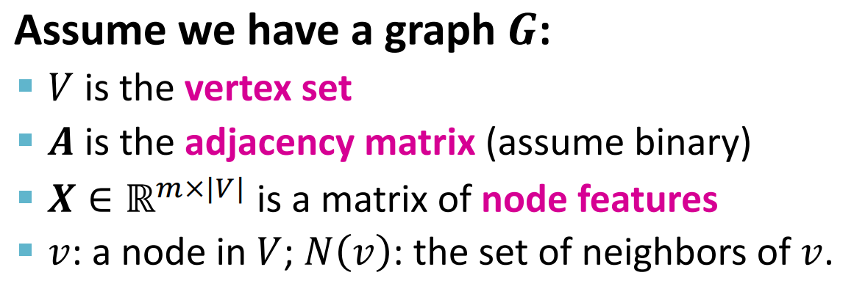

GNN

Slide 2
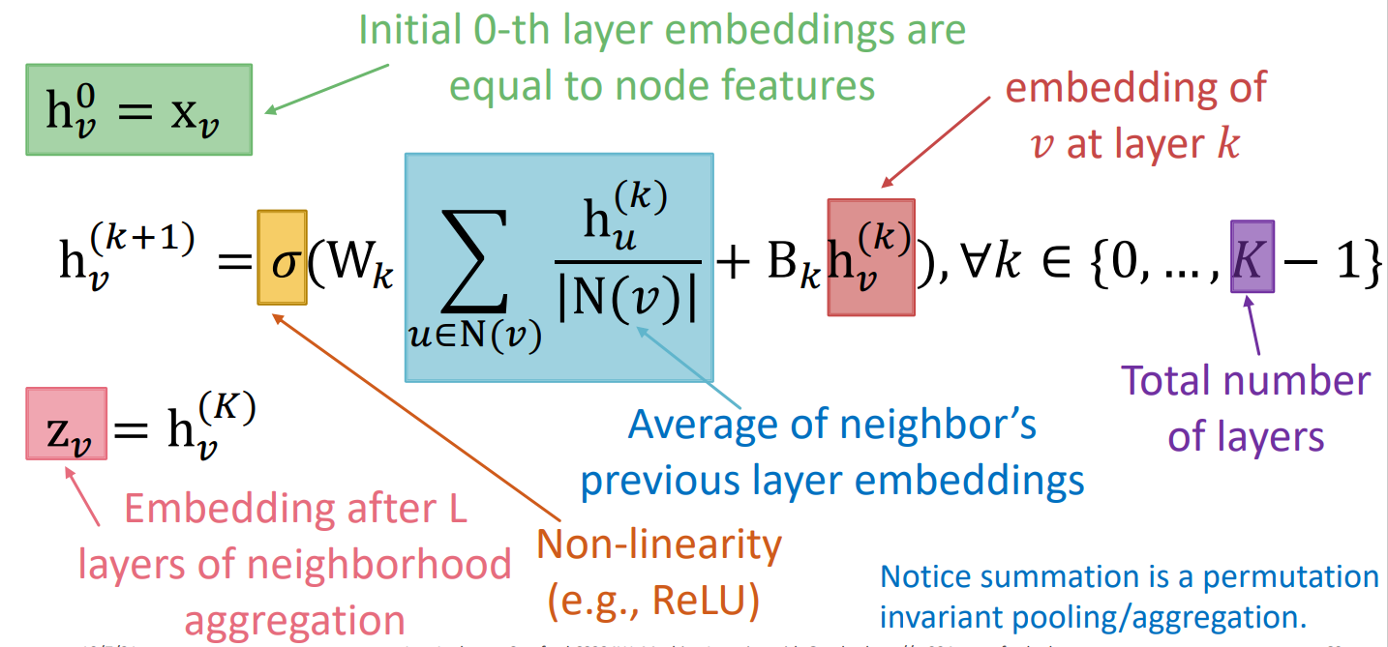
GNN

Slide 3
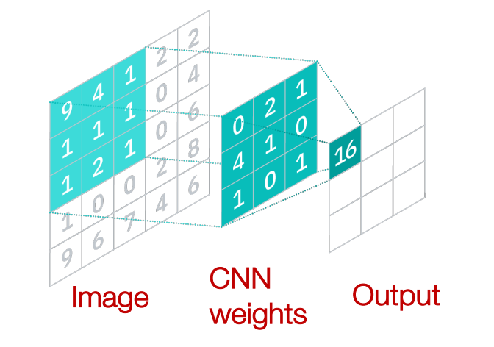
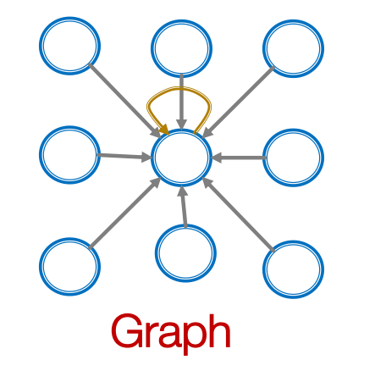

GNN vs. CNN

Slide 4
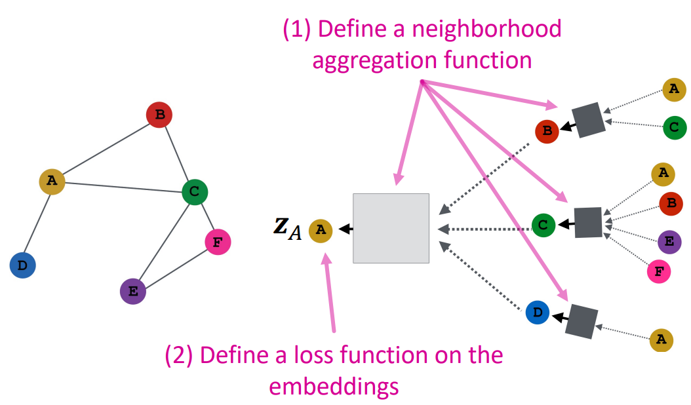





GNN training process

Slide 5


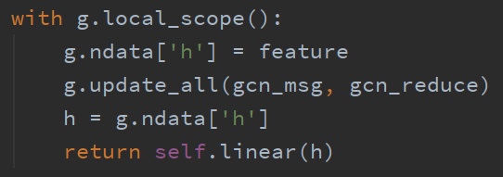



GCN
Normalize A

Slide 6




GraphSAGE
from dgl.nn import SAGEConv
SAGEConv(in_feats, h_feats, 'gcn')
SAGEConv(in_feats, h_feats, 'mean')
SAGEConv(in_feats, h_feats, 'max')
SAGEConv(in_feats, h_feats, 'lstm')

Slide 7

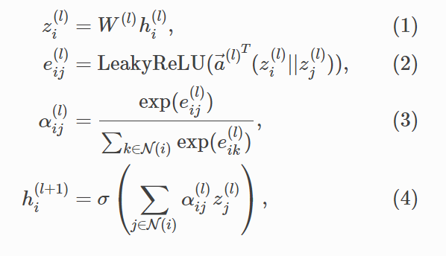
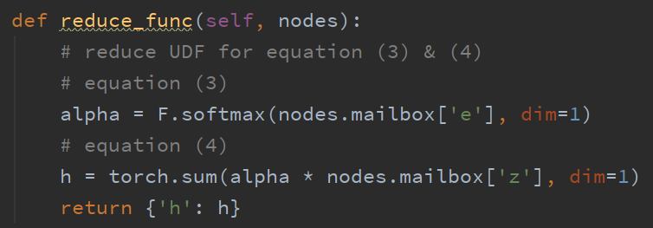
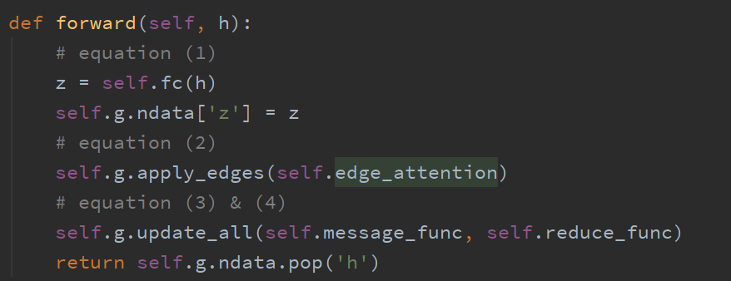
GAT

